Slide 1
Predicting Stock Market Trend using Daily News Headlines
Smit Anish Kiri, Nitin Kumar Mittal
[MSDS Fall 2019]
December 9, 2019

Slide 2
Problem Objective
To classify stock market trend for next day by news headlines and stock data.
Stock market is volatile
News headlines have an impact on buying and selling of the stocks
Trend can be classified into increase, decrease or same
Increase: if next day’s close increases more than 0.5% compared to current open
Decrease: if next day’s close decreases more than 0.5% compared to current open
Same: if next day’s close is within 0.5% change in open of current day

Slide 3
Datasets Used
Reddit News Dataset (textual data): Dataset contains 1989 records, top 25 News headlines by Reddit from August 08th, 2008 to May 01st, 2016.
The News Aggregator Dataset (textual data): Dataset contains headlines, URLs, and categories for 422,937 news stories from March 10th, 2014 and August 10th, 2014.
Daily Stock Market Data (numerical data): The stock data can be scrapped using the pandas_datareader library in python

Slide 4

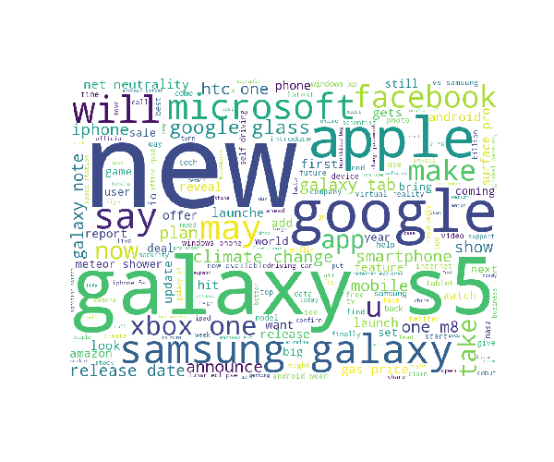
About Textual Data
Reddit News Dataset
UCI News Aggregator Dataset

Slide 5
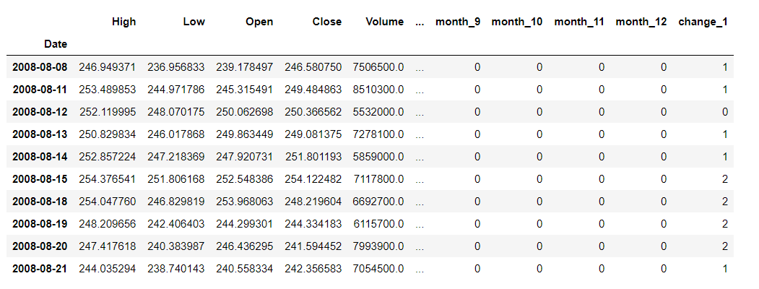
About Stock Data
Stock Data for Google from August 08th, 2008 to May 01st, 2016.
Output Labels:
1 - Increase in stock value
2 - Decrease in stock value
0 - No change in stock value

Slide 6
Approach
1. Using Conventional Models with Stock data (numerical)
Decision Tree
Random Forest
Neural Network
2. Using Conventional Models with Bag-of-Words Encodings for Textual data
News Data - Random Forest, AdaBoost, Neural Network
Combined News and Stock Data - Random Forest, AdaBoost, Neural Network
3. Using Recurrent Neural Network Model and Word Embeddings for Sequential Data
LSTM with word embeddings on news headline sequences and stock data sequences

Slide 7
Performance Metrics for Initial Models with Stock Data to Predict Stock Trend
Models | Training Data |  |  | Test Data
 | Accuracy | Precision | Recall | Accuracy | Precision | Recall
Decision Tree | 100% | 100% | 100% | 36.8% | 36.4% | 36.8%
Random Forest (1000 estimators) | 100% | 100% | 100% | 35.0% | 35.5% | 35.0%
Neural Network | 62.6% | 64.7% | 62.6% | 34.7% | 38.4% | 34.7%
Company- Google, from - August 08th, 2008 to May 01st, 2016

Slide 8
Bag-of-Words Encoding for Textual Data
Text encoding technique
Generates document term matrix using most frequent words in text corpus
In document term matrix, columns contain the words (tokens) in vocab and rows contain frequencies for the words corresponding to a sentence
Document term matrix is used to train various machine learning models

Slide 9
Performance Metrics using News Headlines Encoded by Bag-of-Words to Predict Stock Trend
Models | Training Data |  |  | Test Data
 | Accuracy | Precision | Recall | Accuracy | Precision | Recall
Random Forest (1000 estimators) | 100% | 100% | 100% | 36.4% | 36.4% | 36.4%
AdaBoost | 51.9% | 51.9% | 51.9% | 36.4% | 36.4% | 36.4%
Neural Network | 100% | 100% | 100% | 35.2% | 35.2% | 35.2%
Used Reddit News Dataset, combined all 25 news headlines for a single day

Slide 10
Performance Metrics using News Headlines Encoded by Bag-of-Words and Stock Data to Predict Stock Trend
Models | Training Data |  |  | Test Data
 | Accuracy | Precision | Recall | Accuracy | Precision | Recall
Random Forest (1000 estimators) | 100% | 100% | 100% | 36.7% | 36.7% | 36.7%
AdaBoost | 51.7% | 51.7% | 51.7% | 37.4% | 37.4% | 37.4%
Neural Network | 40.9% | 40.9% | 40.9% | 34.4% | 34.4% | 34.4%
Used Reddit News Dataset, combined all 25 news headlines for a single day
Notes:
Improved little bit for Random Forest and AdaBoost, but decreased little for neural network model

Slide 11
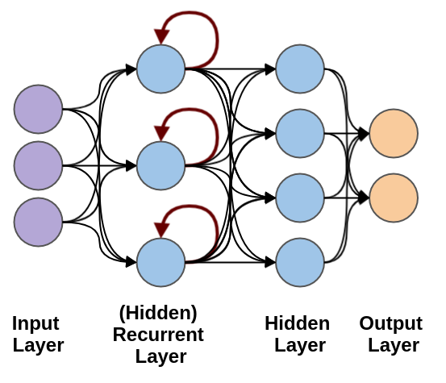
Long Short-Term Memory (LSTM)
LSTM cells are trained to remember what they need to and forget what they don’t.
Why LSTM?
News headlines is sequential in nature
Need to comprehend the meaning of complete sequence

Slide 12
Data Preparation for LSTM

Slide 13
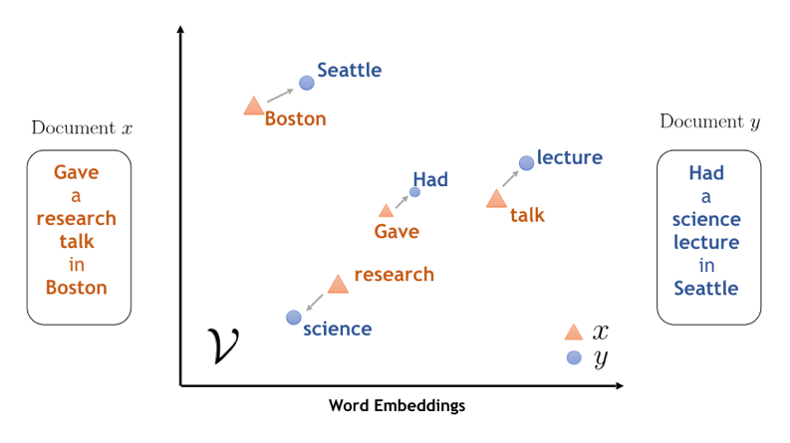
Word Embeddings for Textual Data
Word embeddings provide vector representation of words in corpus
Similar vector representation for similar kind of words
Why Word Embeddings?
Bag-of-Words encoding treats each word as an individual entity, not able to identify similar words
Word embeddings help algorithm to generalize between words

Slide 14
Word Embeddings (GloVe) for News Headlines
Cleaning the news
Preparing vocabulary for the news corpus
Updating vocab with word indexes by keeping words with frequency greater than threshold or present in GloVe vector embeddings
Adding indexes for unknown words and padding
Getting vector embeddings from GloVe for updated vocab
Converting text in news headlines to sequence of word indexes for every day news
Combining single day news indexes and limiting news sequences to a fixed length

Slide 15
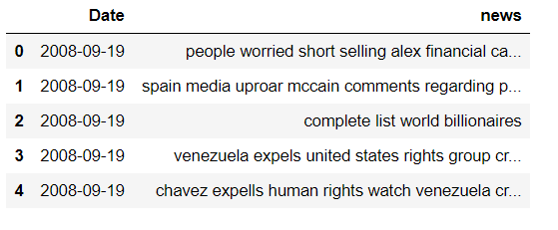
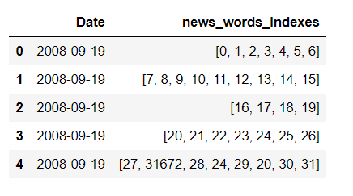
Preparing News Sequences
Converting news into word index sequences

Slide 16
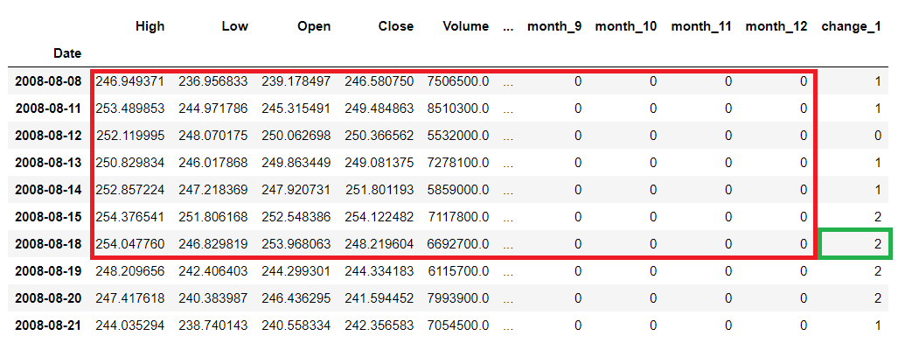
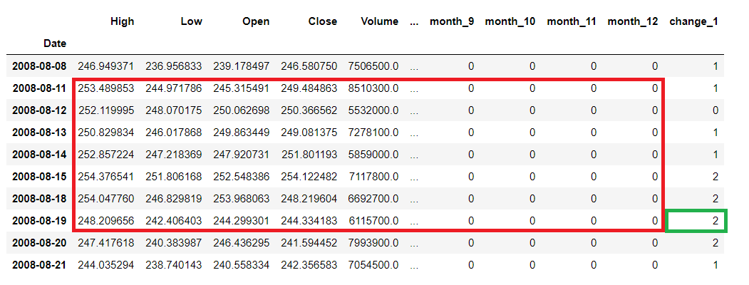
Preparing Sequential Stock Data
Used sequences of previous 30 days stock data
Sequence of previous 7 days stock data to predict stock trend for next day

Slide 17
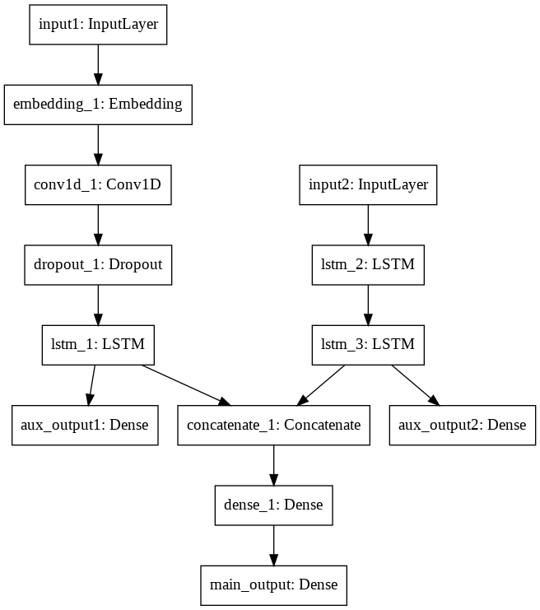
Model Architecture
News Sequences
Stock Sequences

Slide 18
Performance Metrics for LSTM
Data Type | Training Data |  |  | Test Data
 | Accuracy | Precision | Recall | Accuracy | Precision | Recall
Using News Sequences | 42.8% | 42.8% | 42.8% | 36.7% | 36.7% | 36.7%
Using 30 days Stock Sequences | 34.9% | 34.9% | 34.9% | 32.4% | 32.4% | 32.4%
Combined 30 days Stock and News Sequence | 39.6% | 39.6% | 39.6% | 40.0% | 40.0% | 40.0%
Used Reddit News Dataset, combined all 25 news headlines for a single day and 30 days stock sequences for Google
Notes:
Expected a hell lot of improvement but didn’t

Slide 19
Why Poor Performance Metrics for LSTM?
Reddit News dataset does contain relevant text to predict stock market trend for Google Stocks

Slide 20
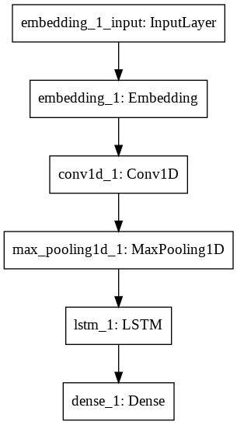
GloVe Word Embeddings and LSTM on UCI News Dataset
News Sequences
The UCI News dataset was filtered and only technology news were extracted
Used pre-trained GloVe word embeddings to encode text in headlines
Trained model to predict the impact of individual news headline on stock trend
Model Architecture

Slide 21
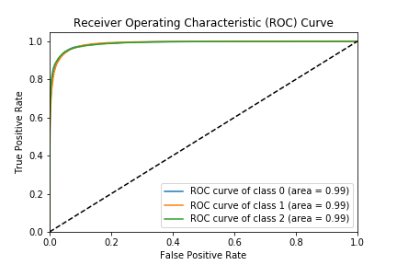
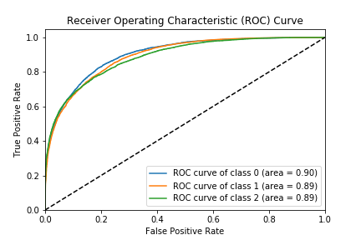
Performance Metrics for LSTM using UCI News Dataset
 | Accuracy | Precision | Recall
Training Data | 92.6% | 92.5% | 92.6%
Test Data | 73.5% | 73.4% | 73.5%
Training Data
Testing Data

Slide 22
Conclusions
Quality and type of news data matters, the Reddit News dataset did not have a lot of technology news which made it difficult for the model to learn
We got better results at predicting impact of individual news headlines on stock trend instead of combining several news headlines into one
Large future scope for the project
Predicting stock trend is a difficult task, otherwise data scientists would have been millionaires!

Slide 23
Acknowledgements
Prof. Alina Oprea
Andrew Ng
Coursera

Slide 24
Questions?

Slide 25
Thank You

